Slide 1
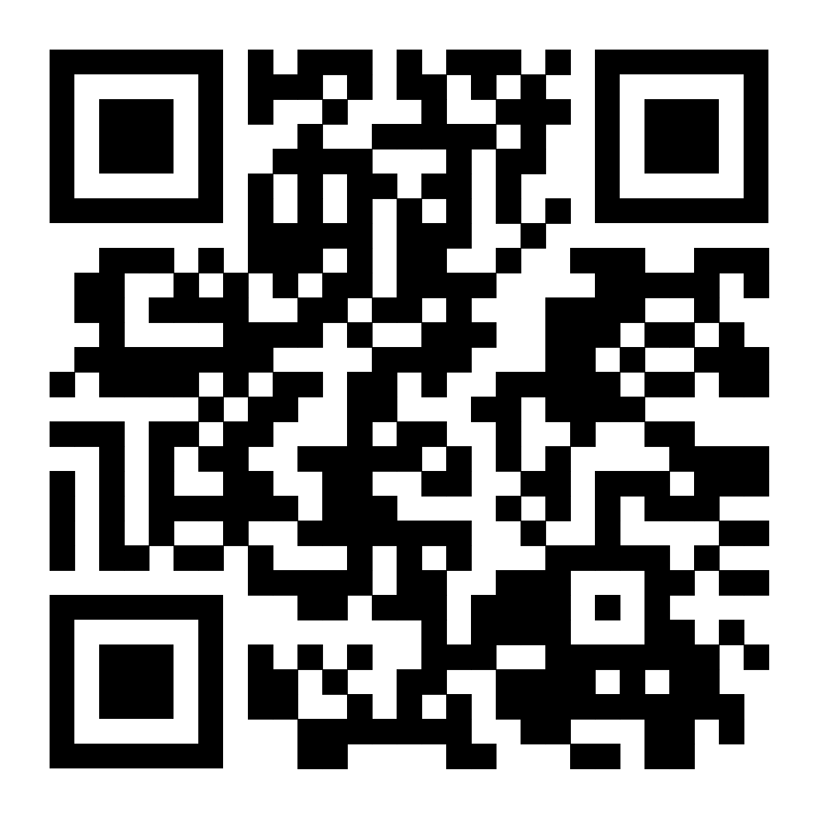
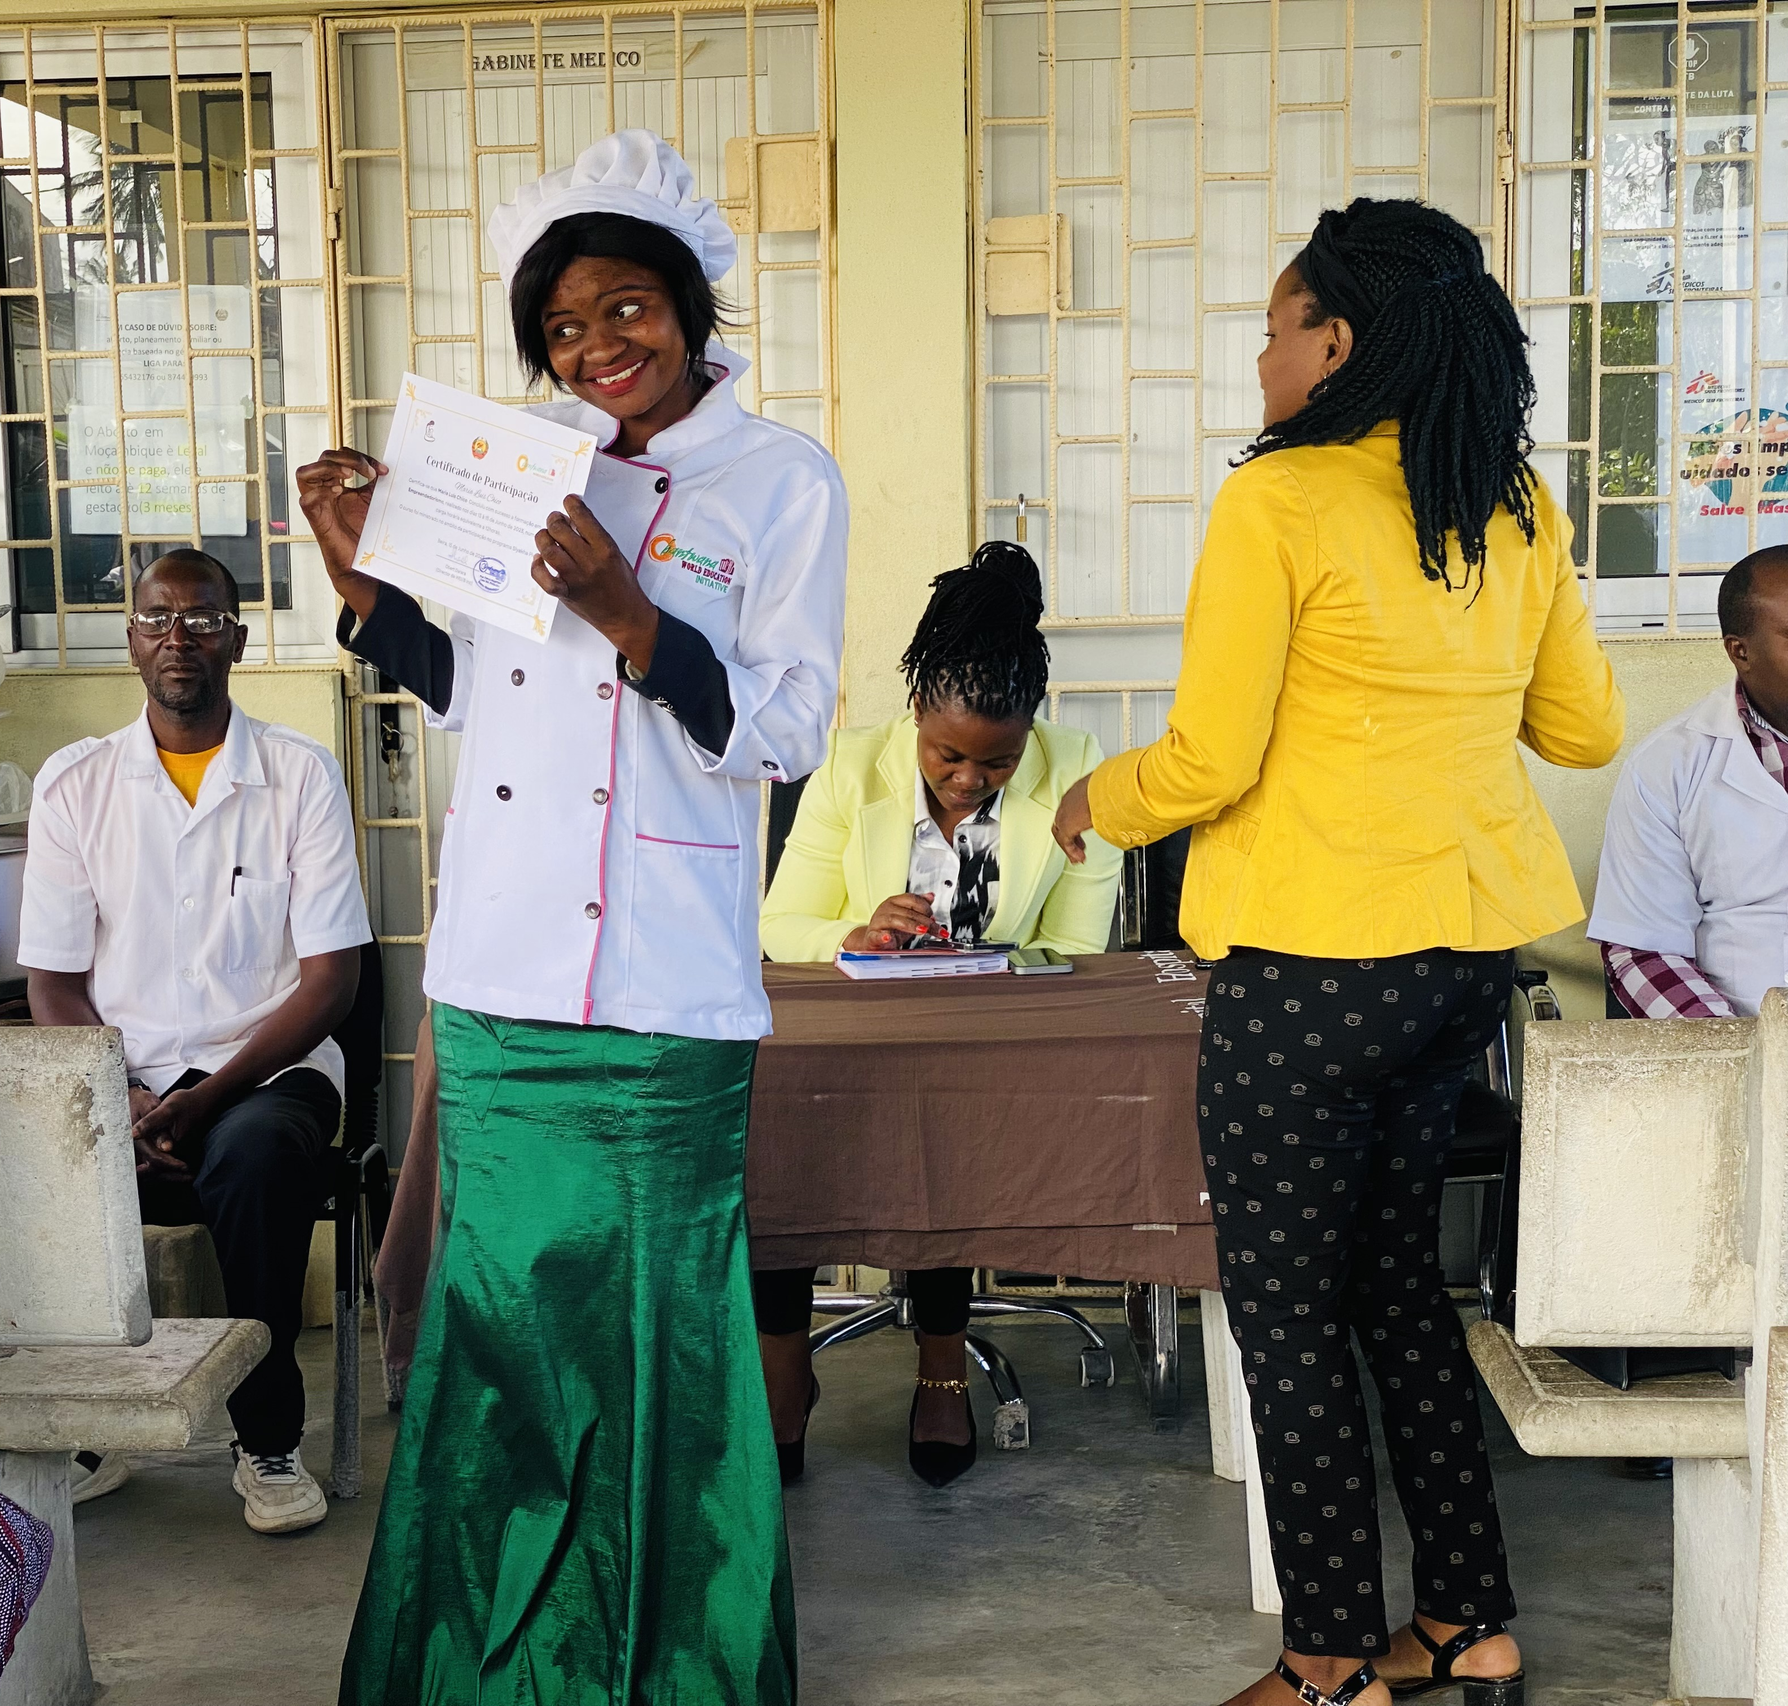
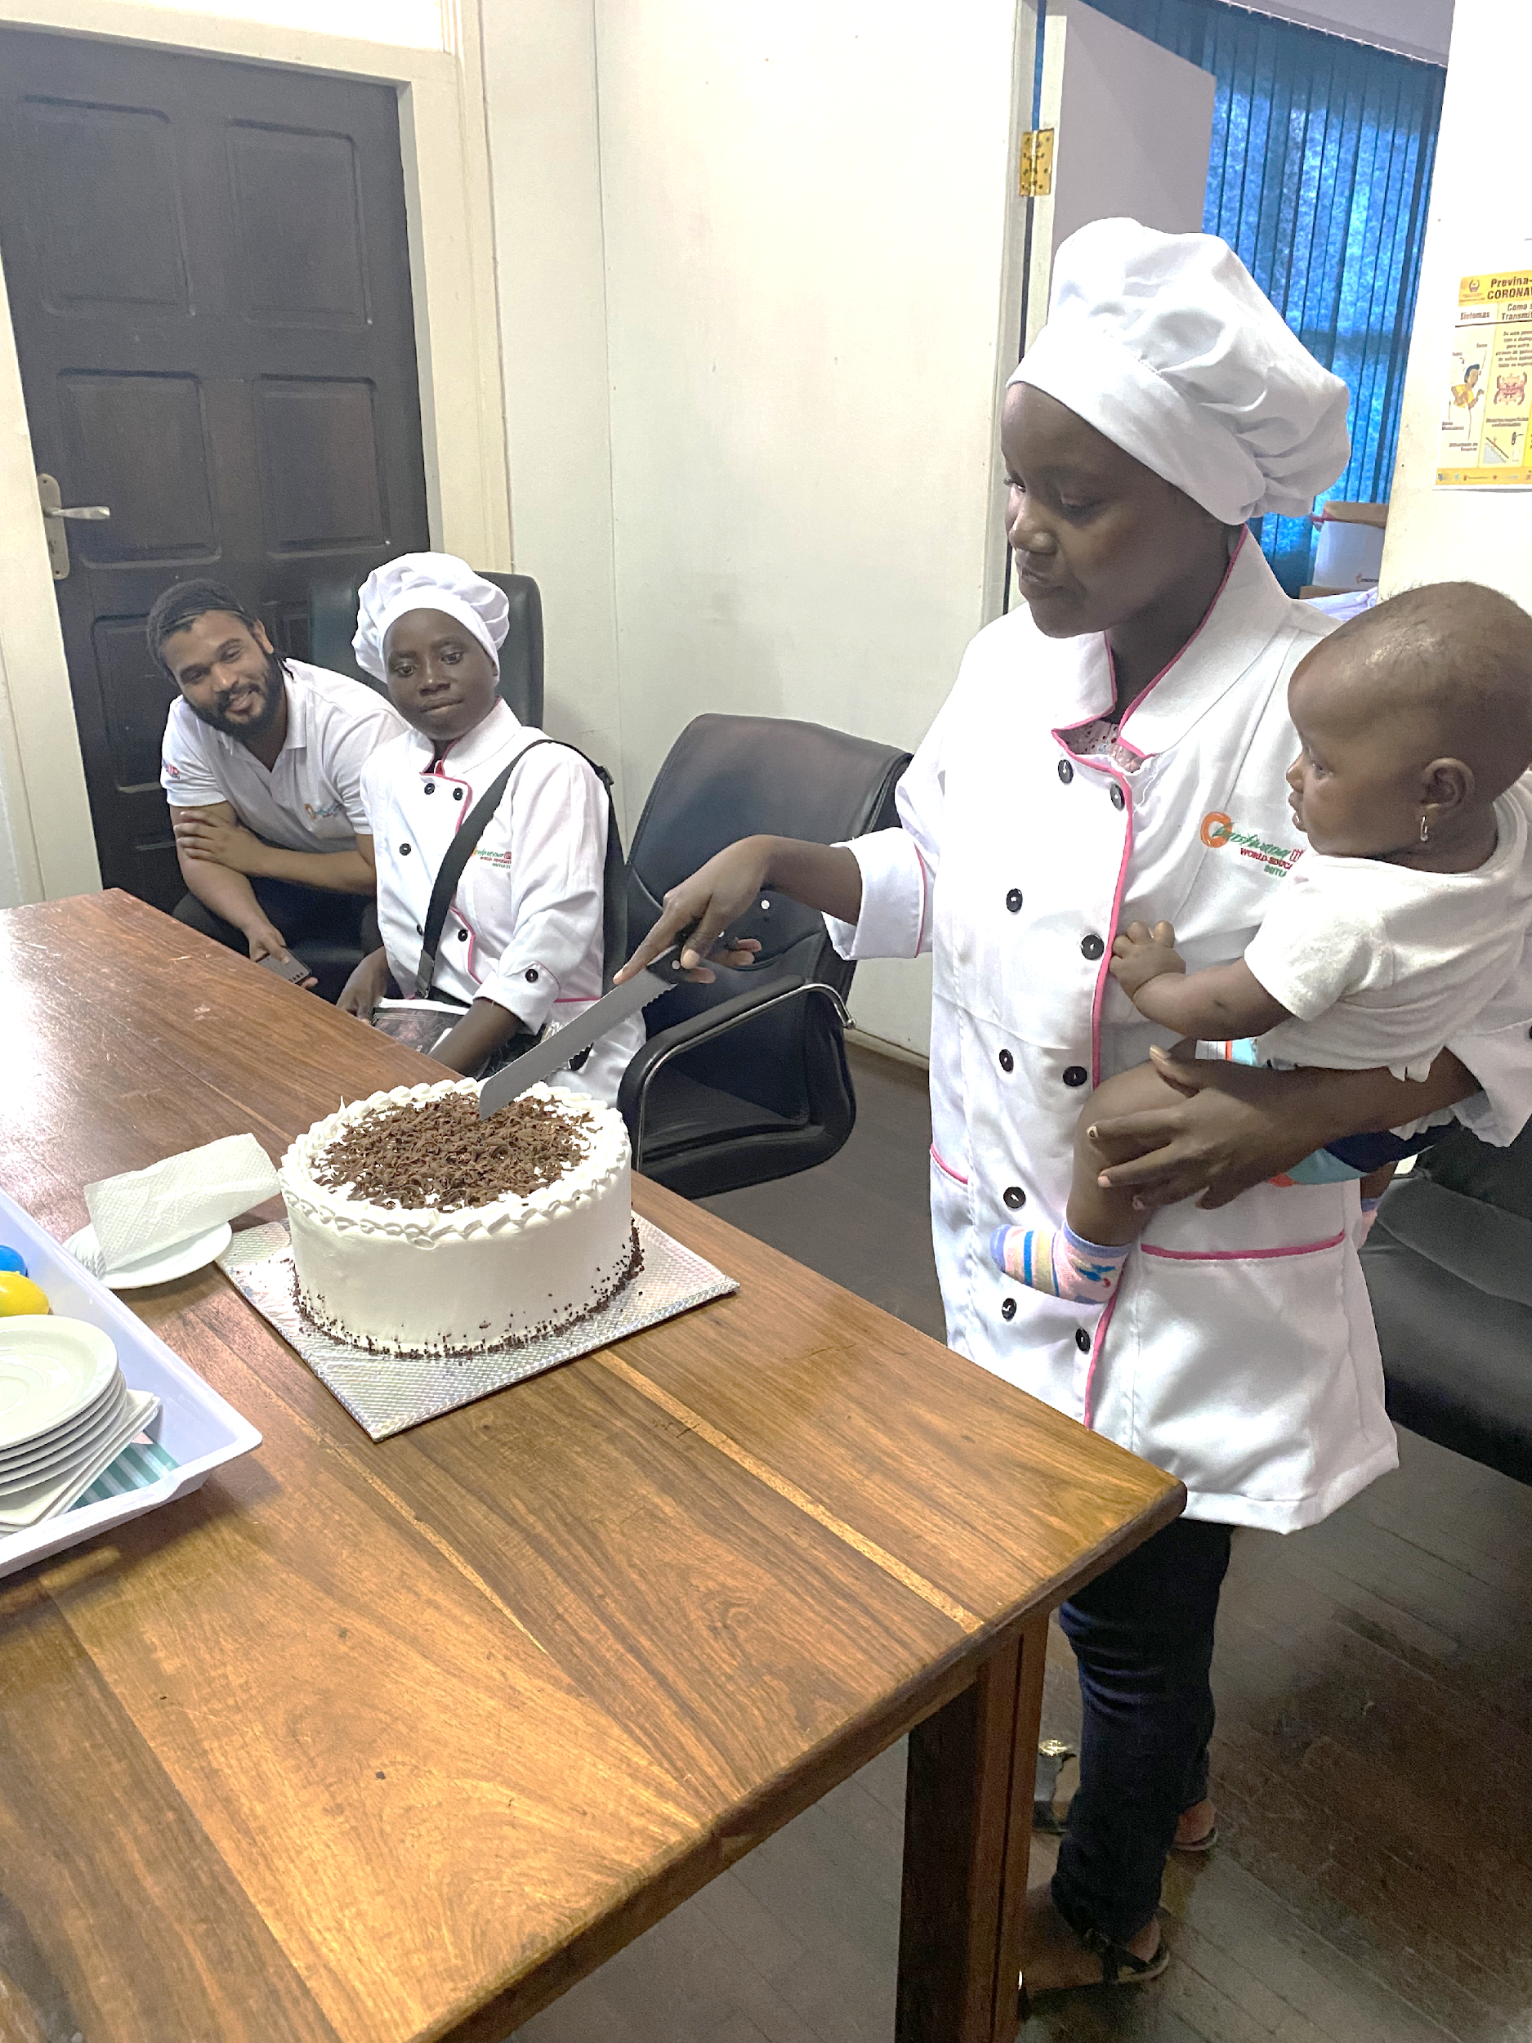
Engaging community actors, health providers and local artisans in Mozambique to strengthen the resiliency of young, breastfeeding mothers living with HIV to keep their babies negative.
Background
Vertical transmission rates among young mothers in Mozambique remains high, with highest EID positivity rates among infants born to women aged 15-24 years. This is due in part to poor involvement of various providers, and gaps in implementation approaches to destigmatize PMTCT interventions that retain teen mothers facing various care and treatment challenges. In response, Siyakha Plus program delivered a set of services to optimize young mothers’ adherence to treatment; motivate them to achieve viral suppression and keep their babies HIV negative; and improve their agency and technical capacity to thrive in the local economy.
Description
From November 2022 to September 2023, the Bantwana Initiative of JSI engaged health providers from two high-volume health facilities’, local artisans, and community actors in Sofala Province, to support 55 HIV+ lactating young mothers (aged 15-25) and their infants through our Siyakha Plus resiliency strengthening program. The project addressed the realities of HIV+ teen mothers by creating savings groups to promote social cohesion, layering on behavior change messaging and services; recruiting community actors that embedded a mentoring approach, encouraging disclosure to reduce stigma; engaging health facilities for individualized HIV support services; and linking women to local artisans for skills training.
Lessons Learned
Results show that young women achieved viral suppression (from 53% to 92%) and kept their babies HIV negative (100% confirmed negative PCR test); increased support from their intimate partners (65% to 92% disclosure to intimate partners). Self-reported improved agency and technical capacity in baby care and breastfeeding practices; adherence and treatment literacy, with high motivation to keep their babies negative; and management of their small businesses. We learned that young mothers are receptive of adherence and stigma support and prefer it packaged to their personalized need and context; a multisectoral emphasis helps create a workforce sensitive to and supportive of HIV+ women.
Conclusion & Next Steps
The program reduced risk of vertical transmission among young mothers by reducing stigma and enhancing economic participation and resilience. We continue to support Government, health facilities and communities to reduce positivity rates among babies born to young women living with HIV, thus addressing a key public health challenge in (and beyond) Mozambique.
Scan QR code to learn more

