Slide 1
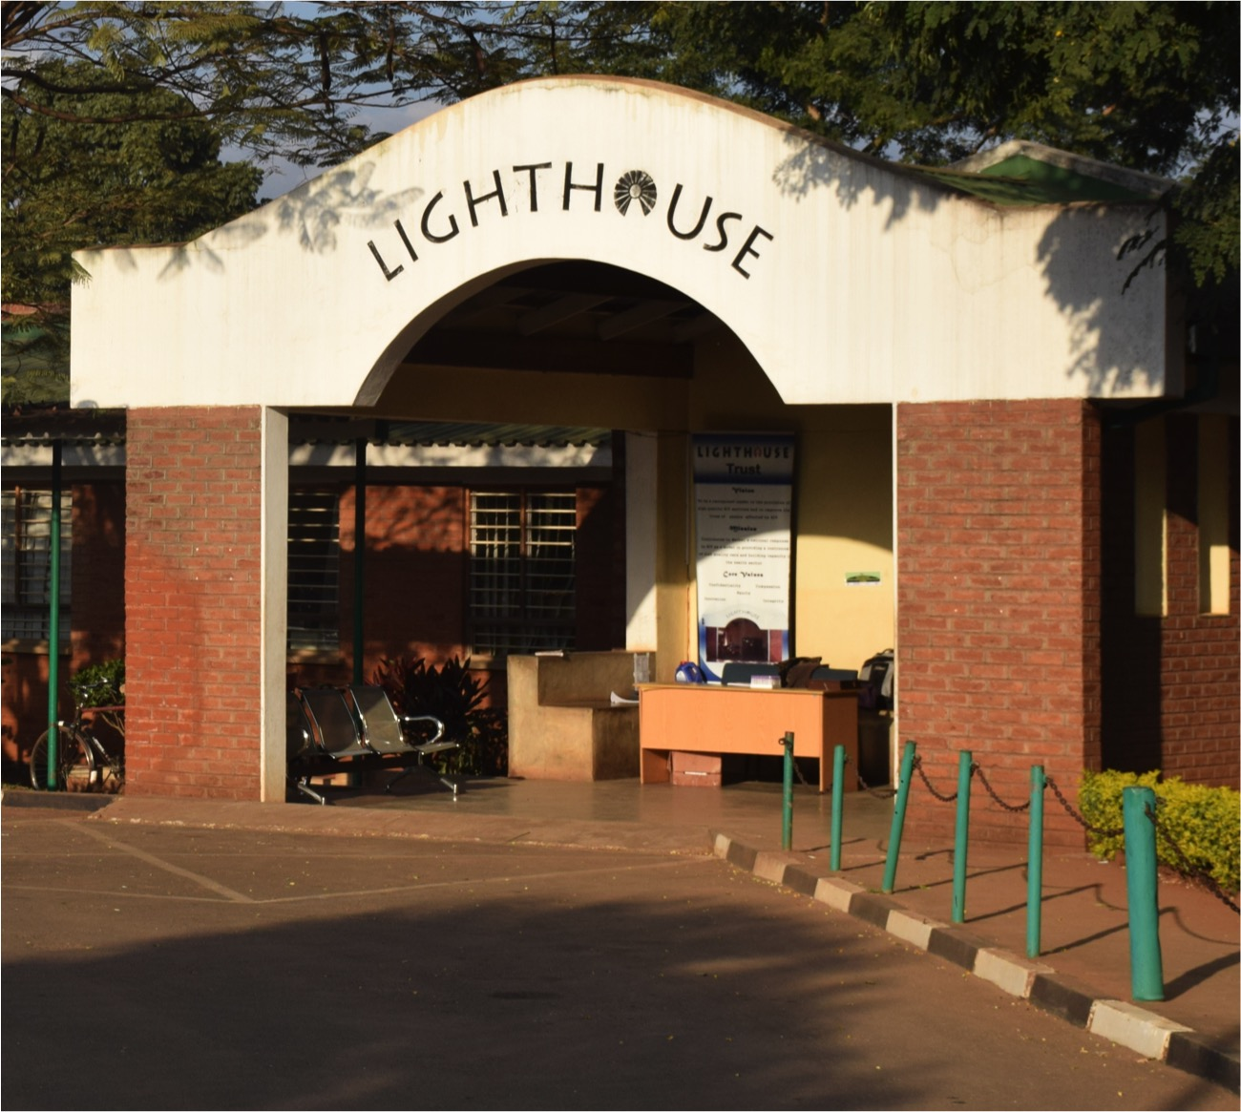
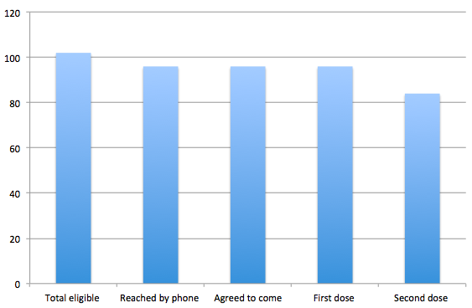
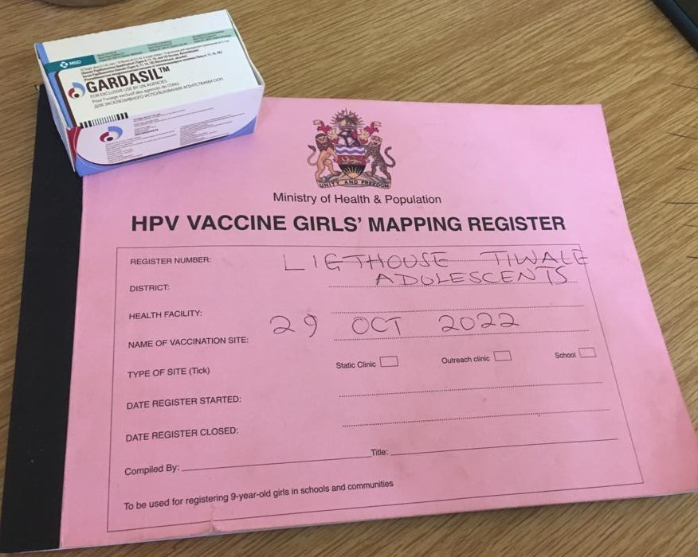
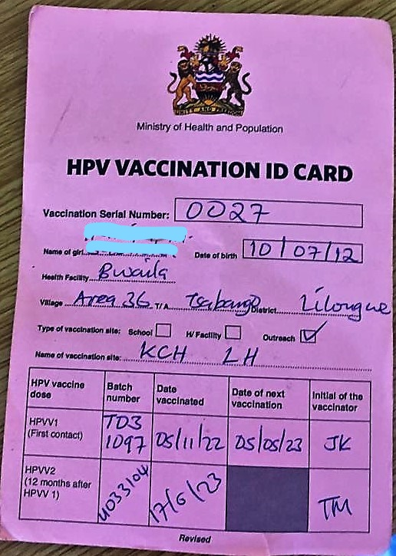
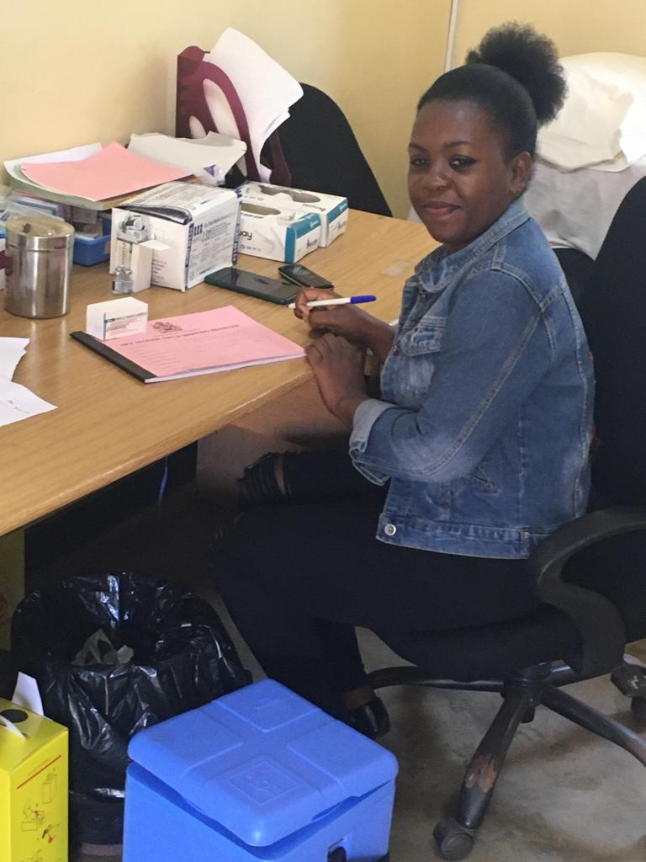
Lessons learnt from HPV vaccination program among girls living with HIV at Lighthouse clinic, Lilongwe, Malawi
Damba D¹, Qaba R¹, Rambiki E¹, Mhone B², Heller T ^{1,3} , Wallrauch C¹
.
Introduction
Cervical cancer is the leading cancer among women in Sub-Saharan Africa. Women living with HIV are particularly at risk of acquiring oncogenic HPV strains leading to cervical cancer development. Worldwide, HPV vaccination is recommended as effective prevention intervention against cervical cancer. Malawi adopted HPV vaccination in 2018 for girls aged 9-14 years. The program mainly focused on a school-based approach and did not include specific approaches for HIV+ teenagers for whom three doses of vaccine are recommended. COVID-19 has aggravated existing vaccine hesitancy, leading to further slowing of the program
Result
A total of 102 eligible adolescents; 91 (89%) were vaccinated The median age at vaccination was 12 years; their median time on ART was 6.9 years [IQR 4.8-9.1]. 72 (79%) of the 91 girls had a viral load result in the past 12 months and 66 (92%) were virologically suppressed (<1000 copies/ml). The vaccination cascade is shown in Fig.2. The third dose of HPV vaccination is planned for December 2023
Intervention
The "Lighthouse HIV+ teen club" started an HPV vaccination campaign for girls aged 10-14 years enrolled at Lighthouse in Lilongwe, Malawi. Due to misinformation and myths surrounding the vaccine none of the guardians agreed to vaccination initially. Following this, an awareness campaign was developed which involved a simple description of the HPV vaccine, its benefits and possible side effects. These were discussed with each guardian on phone and subsequently in person during a guardian awareness session. During this, also signed consent was obtained. In parallel, teens received age-adapted information about the vaccine and procedure. Vaccination side effects were actively monitored and guardians were encouraged to report side effects after returning home. A post-vaccination survey was conducted on a random subset (approx. 50%) of guardians on perception and experience of HPV vaccine using a questionnaire centring on knowledge, tolerance and satisfaction with vaccination service
Satisfaction and side effect interview
During questionnaire-guided interviews (n=44), 20/44 (45%) guardians reported to have had heard about HPV vaccine before and 98% knew that it protects against cervical cancer. 35 (80%) commented that they had received sufficient information about the vaccine before procedure; 20% however mentioned that they had received only minimal/not enough information. The vaccine tolerance was very high (95%); only two girls had side effects (one pain on injection site; one skin rash). Almost all (43/44 (98%)) would recommend the vaccine to other eligible girls. One guardian still believed that the vaccine could lead to sterility and withdrew her consent for any second dose.
Conclusions
After adequate information all guardians and girls who participated in the awareness sessions consented to HPV vaccination. Side effects are rare and the vaccine was well tolerated. In the follow-up interview the vaccine was generally well perceived among guardians and only minimal vaccine hesitancy was encountered
Study aim
To assess and improve acceptability and coverage of HPV vaccination among adolescent girls of 10-14 years accessing care at Lighthouse Teen Club
Methods
Study design - Retrospective record review Study setting - Lighthouse Trust –Kamuzu Central Hospital Study population - Adolescent girls of age 10 to 14 years Study period - October 2022 – November 2023 Data sources - Data extracted from adolescent clinic records and adolescent preventive database
Affiliations
¹Lighthouse Trust, Lilongwe, Malawi, The Malawi Extendedn Program on Immunizations, lilongwe Malawi ³International Training and Education Center for Health, University of Washington, Seattle, WA, United States

