Slide 1
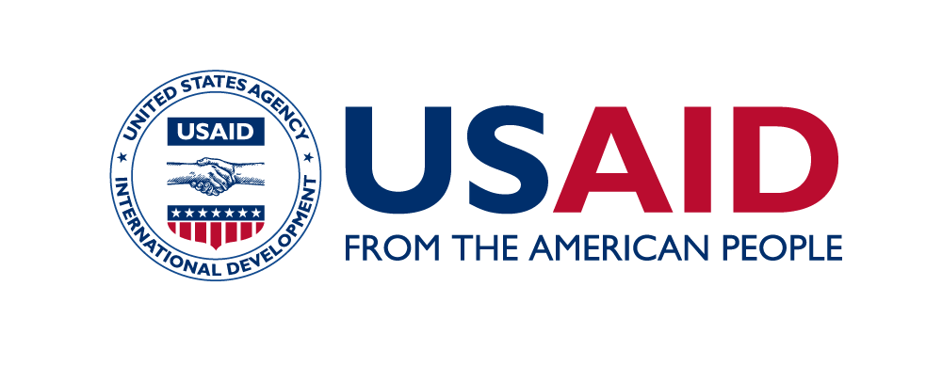
Pediatric Blended Performance Assessment Approach (P-BPAA): Measuring and Improving the Quality of Pediatric HIV Care in Southern Nigeria.
Abstract ID: 339
O. Ogungbade¹, O. Adegbite², O. Majekodunmi², C. Umeh², O. Kalu-Oji², B. Ochonye², D. Ogundehin³, O. Igboelina³, K. Green¹
1. West Africa Centre for Public Health and Development (WACPHD), Nigeria, 2. Heartland Alliance Limited Guarantee (HALG), Nigeria, 3. United States Agency for International Development (USAID), Nigeria.
Speaker name: Oluwatosin Temitope Ogungbade
Background
To achieve HIV epidemic control by 2030 in line with UNAIDS targets, it is critical that no subpopulation is left behind across the 95-95-95 paradigm. The USAID-funded project, Accelerating Control of HIV/AIDS Epidemic (ACE)-cluster 6 implemented the Pediatric Blended Performance Assessment Approach (P-BPAA) to improve the quality of care for children accessing ART at supported facilities and thereby improve their clinical outcomes. We aim to establish how the use of the P-BPAA tool has helped in improving the quality of care of pediatric patients in selected hospitals within Southern Nigeria.
Methods
Pediatric BPAA, a performance measurement and continuous quality improvement (CQI), was adapted from the U.S. HIVQUAL model, and the Site Improvement Monitoring System (SIMS) tool – a PEPFAR monitoring tool, incorporating Nigeria HIV national guidelines as standards. In each of ninety-five pilot-site hospitals in Southern Nigeria in 2022–2023, clinical data abstracted from patient records were used to identify priority areas for CQI.
Results
At the ninety-five hospitals supported within the three states, 3101 HIV-infected children less than 15 years of age were cared for between January – June 2022; 3,314 between July – December 2022, and 3,505 between January – June 2023 – of whom 547, 553, and 558, respectively, were selected for chart abstraction considering the confidence level of 99% and margin of error of 5%. Of the eligible, ≥ 95% received clinical monitoring, bi-annual viral load monitoring, ART, and medication adherence and growth monitoring; about 80% know their HIV status. The following quality indicators - Management of Antiretroviral (ARV) Therapy, Viral load monitoring, and HIV disclosure with a score ≤ 65% in the first half of 2022 had a great improvement (p <0.05) in the second half of 2022 and the first half of 2023 following the implementation of the CQI activities. This aided the improvement of the retention rate and viral suppression with ≥ 95% outcomes seen in all the charts reviewed.
Conclusion
The pediatric Blended Performance Assessment Approach (BPAA) model facilitates the use of hospital data for pediatric HIV care improvement and indicates that the BPAA model is adaptable to resource-constrained countries.

