Slide 1
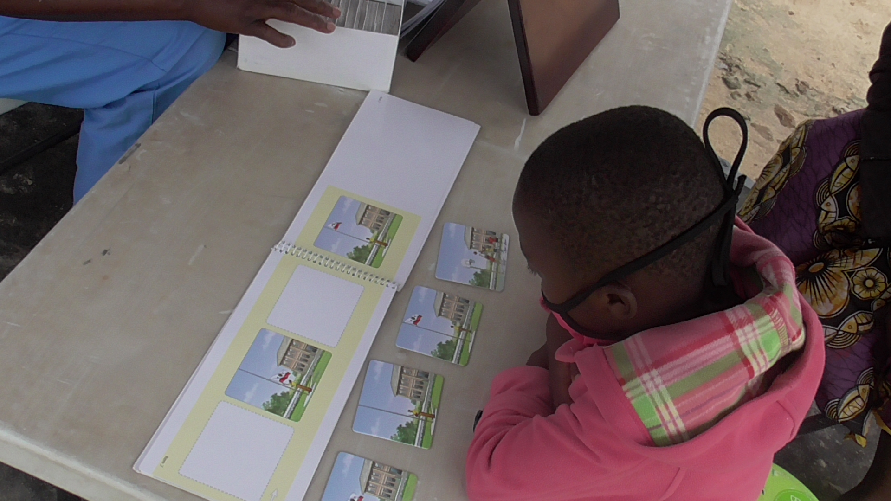
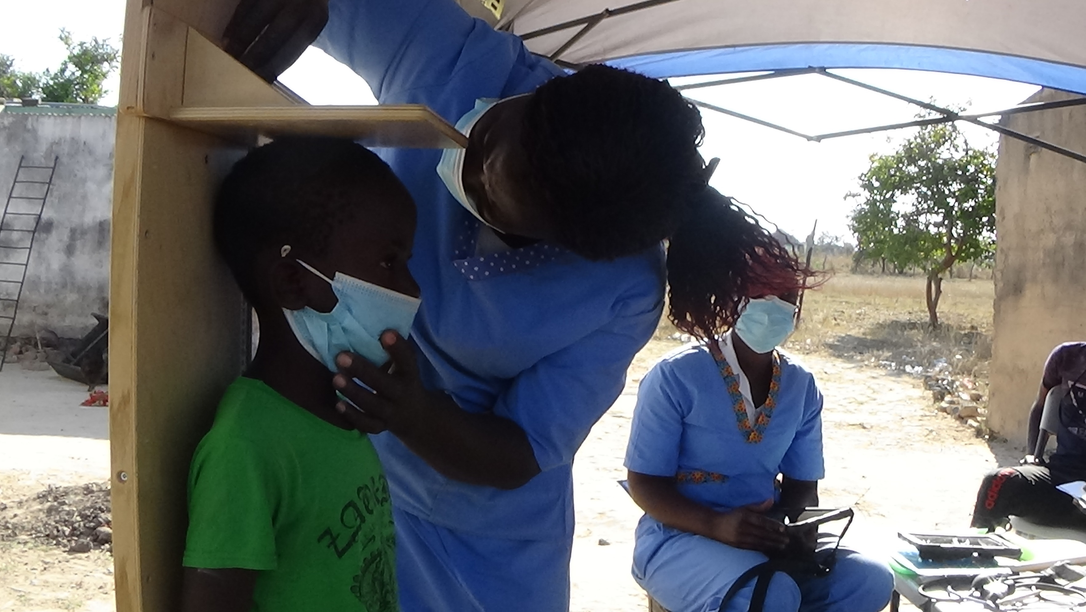
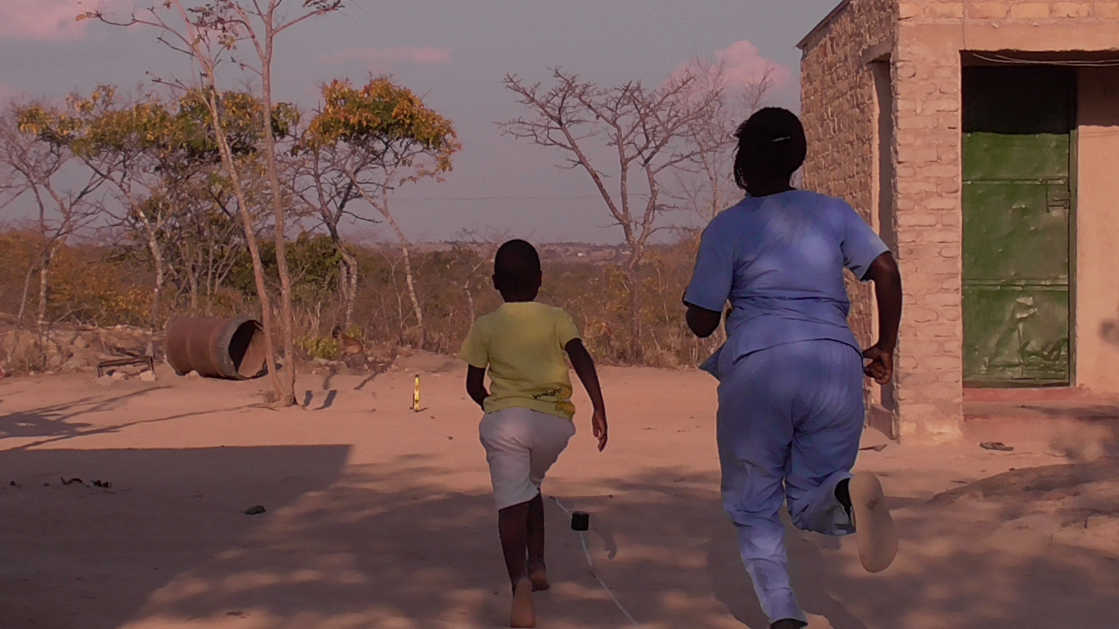
Growth, physical and cognitive function in children who are born HIV free, school age follow-up of a cluster randomized trial in rural Zimbabwe
Marian Mwapaura¹, Clever Mazhanga¹, Idah Mapurisa¹, Tsitsi Mashedze¹, Eunice Munyama¹, Gloria Mapako¹, Thombizodwa Mashiri¹, Dzidzai Matemavi¹, Maria Kuona¹, Kundai Sibanda¹, Manasa Mangwende¹, Monica Tichagwa¹, Soneni Nyoni¹, Asinje Saidi¹, Joice Tome¹, Dzivaidzo Chidhangaro¹, Eddington Mpofu¹, Batsirai Mutasa¹, Melissa Gladstone³, Jonathan Wells⁴, Jean H Humphrey⁵, Lisa Langhaug¹, Naume Tavengwa¹, Robert Ntozini¹, Melanie Smuk², Joe D Piper^{1,2,6}, Andrew J Prendergast^{1,2}.
¹ Zvitambo Institute for Maternal and Child Health, ²Queen Mary University of London, ³University of Liverpool, ⁴Institute of Child Health, ⁵Johns Hopkins, ⁶London School Hygiene & Tropical Medicine
Methods
Academic
SAT
1275 children from the SHINE trial measured using the SAHARAN toolbox:
Executive Function (Plus EF)
Outcome | Children born HIV-free (CBHF) |  | HIV-unexposed (CHU) |  | GEE Mean difference (95% CI)
 | N | Mean (SD) | N | Mean (SD) | Unadjusted difference | Adjusted difference Model 1 (Trial factors) | Adjusted difference Model 2 (Trial factors & contemporary covariates) | Adjusted difference Model 3 (Trial factors & baseline covariates)
KABC-II total | 264 | 45 (11) | 990 | 48 (11) | 3 (2, 4) | 3 (2, 4) | 3 (1, 4) | 3 (2, 4)
Academic | 264 | 39 (26) | 990 | 46 (28) | 7 (4, 11) | 7 (3, 11) | 6 (2, 10) | 6 (3, 10)
Plus EF | 251 | 109 (25) | 978 | 114 (24) | 5 (2, 8) | 5 (2, 8) | 5 (2, 8) | 5 (2, 9)
VO₂max | 255 | 50.2 (2.7) | 986 | 50.9 (2.7) | 0.8 (0.4, 1.2) | 0.6 (0.2, 1.0) | 0.5 (0.1, 0.9) | 0.5 (0.1, 0.9)
Head circ, cm (SD) | 263 | 51.0 (1.5) | 990 | 51.3 (1.4) | 0.3 (0.1, 0.5) | 0.3 (0.1, 0.5) | 0.3 (0.1, 0.5) | 0.3 (0.1, 0.5)
Socio-emotional SDQ
Cognition
Kaufmann Assessment Battery (KABC-II): total is the
Mental processing index (MPI)
Fine motor
1000 born to mothers without HIV
7 living with HIV
Growth
BIA (Lean mass index)
Skinfolds,
Knee-heel length
Anthropometry
Physical function
Grip strength,
broad jump
Shuttle Run test,
Hb, BP,
Measuring cognition using the KABC-II
Table 1: Cognitive outcomes at 7 years for CBHF and HUU children.
268 born HIV-free (CBHF)
*Model 1 adjusted for trial arm, study nurse, age, calendar age recruited, temperature, sex
* Model 2 adjusted for trial factors plus contemporary factors (socioeconomic status, caregiver depression score (EPDS), household food insecurity (HFIAS), household religion, caregiver social support, caregiver gender norms, caregiver age, caregiver education, adversity score, children’s books at home).
*Model 3 adjusted for trial factors plus Anthro at 18mo, birth weight, depression, household diet, maternal haemoglobin, SES, born in facility, gender norms attitudes, maternal schooling,
CBHF had lower scores by 0.2-0.3 SD in :
KABC-II total score (Mental processing index, MPI)
School Achievement Test
Plus EF
CBHF also had lower Cardiovascular fitness (VO₂max)
CBHF also had smaller head circumference (0.3cm).
Participant characteristics from the SHINE trial
1000 children born to HIV-negative mothers were compared with 268 children born HIV-free (CBHF) HIV-positive mothers in rural Shurugwi
Pregnancy characteristics were broadly similar:
Mothers with HIV had lower hemoglobin and MUAC, and higher parity than mothers without HIV,
Mothers with HIV had higher depression and food insecurity scores, and lower socioeconomic scores.
By 18 months, CBHF had lower anthropometry, with higher rates of stunting and a lower breastfeeding duration
Measuring height
Conclusion
CBHF had reduced cognitive function, cardiovascular fitness & head circumference, including for adjusted models.
The Medical Research Council of Zimbabwe approved the study protocol (MRCZ/A/1675). The SHINE follow-up study was registered with the Pan-African Clinical Trials Registry (PACTR202201828512110).
The Shuttle run test to measure cardiovascular fitness
Contact
m.mwapaura@zvitambo.com
j.piper@zvitambo.com
References
Independent and combined effects of improved water, sanitation, and hygiene, and improved complementary feeding, on child stunting and anaemia in rural Zimbabwe, Humphrey J et al. 2019, Lancet Global Health, Vol 7, e132-e147
Characterising school-age health and function in rural Zimbabwe using the SAHARAN toolbox , Piper, Mazhanga C et al. PLoS One 2023, Vol 18, (5), p e0285570,
The Sanitation Hygiene Infant Nutrition Efficacy (SHINE) Trial: Protocol for School-Age Follow-up Piper J. D, Mazhanga C. Wellcome Open Access 2023, 8:306,
Adaptation of the Kaufman Assessment Battery for Children—2nd edition (KABC-II) to assess school-age neurodevelopment in rural Zimbabwe Piper J. D, Mazhanga C,. Wellcome Open Research, 2022, Vol 7 (274), DOI.
Acknowledgments
We thank the Ministry of Health and Child Care (MoHCC) and the District Health Executive for their support.
We also thank the participants and their families in the Sanitation Hygiene Infant Nutrition Efficacy (SHINE Trial)

