Slide 1
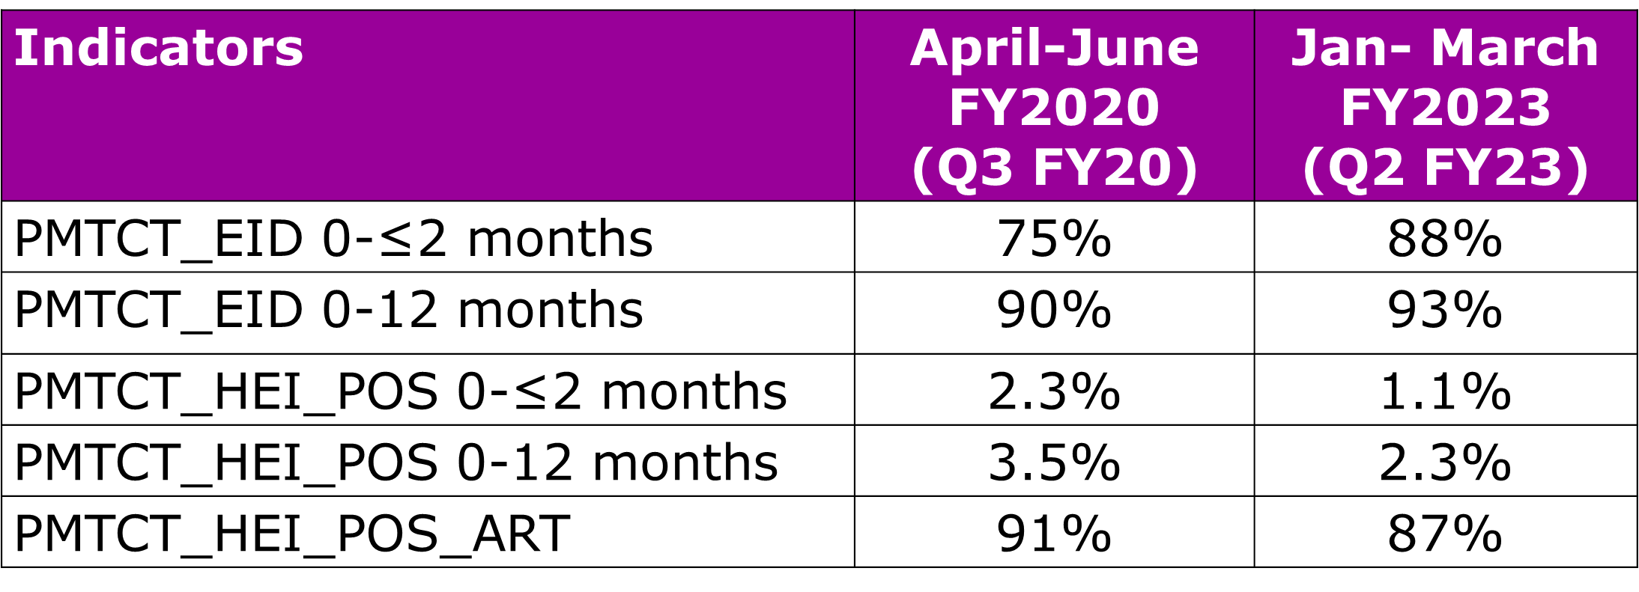
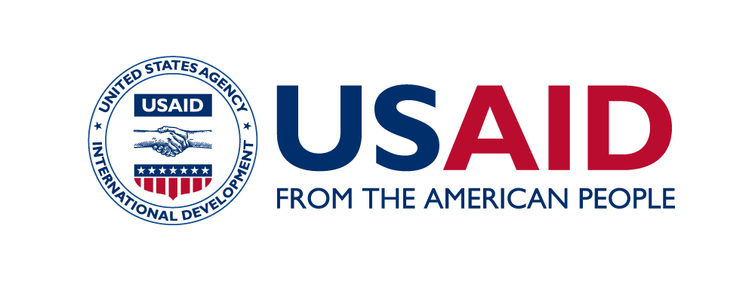
Improving early infant diagnosis and reducing HIV positivity among infants amid the COVID-19 pandemic: Lessons learned from four provinces in Mozambique Argentina Wate¹, Rachel Golin², Ferreira Ferreira¹, Aleny Couto³, Námita Eliseu³, Kwalila Tibana³, Mércia Matsinhe¹, Sílvia Mikusova¹, Nidze Guiloviça¹ ¹United States Agency for International Development, Maputo, Mozambique; ² United States Agency for International Development, Office of HIV/AIDS, Washington, DC, USA; ³Government of Mozambique, Ministry of Health, Maputo, Mozambique
Background
Despite numerous threats exacerbated by COVID-19, Mozambique’s HIV vertical transmission (VT) rate has declined from 14% (2020) to 10% in 2023 (Spectrum 6.29). USAID partners with the Government of Mozambique to prevent VT and provides HIV services to ~25% of all pregnant and lactating women living with HIV (PLWLHIV) and their HIV-exposed infants (HEI) in Mozambique.
Lessons Learned
We analyzed programmatic data from 151 USAID-supported sites at the start of COVID-19 (April - June 2020 [quarter 3 of fiscal year 20 (Q3 FY20)]) and after the initial peaks of COVID-19 (last available reporting period is January - March 2023 [quarter 2 of fiscal year 23 (Q2 FY23)]) in the four provinces.
In Q3 FY20, 75% (4,088/5,268) of HEI received EID testing by 2 months of age and 90% (4,735/5,268) by 12 months of age. The EID coverage increased in Q2 FY23 to 88% (4,560/5,185) by 2 months of age and 93% (4,800/5,185) by 12 months of age.
EID positivity declined from 2.3% to 1.1% for infants < 2 months of age, and from 3.5% to 2.3% for infants <12 months.
ART linkage for infants living with HIV decreased from 91% (Q3 FY20) to 87% (Q2 FY23).
Table 1. Comparison of PEPFAR Monitoring, Evaluation and Reporting Indicators* from the Q3 FY20 to Q2 FY23
Description
USAID/Mozambique collaborated with the Ministry of Health and partners on the following COVID-19 program adaptations to improve HIV services for PLWLHIV and HEI in Manica, Niassa, Sofala, and Tete provinces from April 2020 - March 2023:
Deployed 550 Mentor Mothers (MM) to implement the national MM strategy, including telephonic and limited home support for early infant diagnosis (EID) services and return of results,
Appointed >100 MCH nurses to 97 high volume sites, and;
Supported MCH staff to implement the national EID algorithm, differentiated service delivery models (quarterly clinical consultations and provision of cotrimoxazole prophylaxis), and provide psychosocial support that emphasized timely EID services.
*PEPFAR’s Monitoring, Evaluation, and Reporting Indicator Reference Guides can be accessed here: https://help.datim.org/hc/en-us/articles/360000084446-MER-Indicator-Reference-Guides
Conclusions/Next Steps
These data suggest that PLW and HEI-centered interventions can improve timely infant diagnosis and help to achieve elimination of VT. Further analyses are needed to determine causal effect of interventions on the increase in EID coverage and reduction in HIV testing positivity and ART linkage among infants to inform programming.
Acknowledgements: The authors of this poster would like to thank and acknowledge program participants, health facility staff, community cadres,, civil society, and implementing partners for their partnership in the PMTCT program.
Disclaimer: This poster was made possible by the support of the American people through the U.S. States Department of State’s Bureau of Global Health and Security (GHSD) and the United States Agency for International Development (USAID) under the U.S. President's Emergency Plan for AIDS Relief (PEPFAR). The contents in this article are the sole responsibility of the authors, and do not necessarily reflect the views of GHSD, USAID, PEPFAR or the United States Government.
Notes:
1

