Slide 1
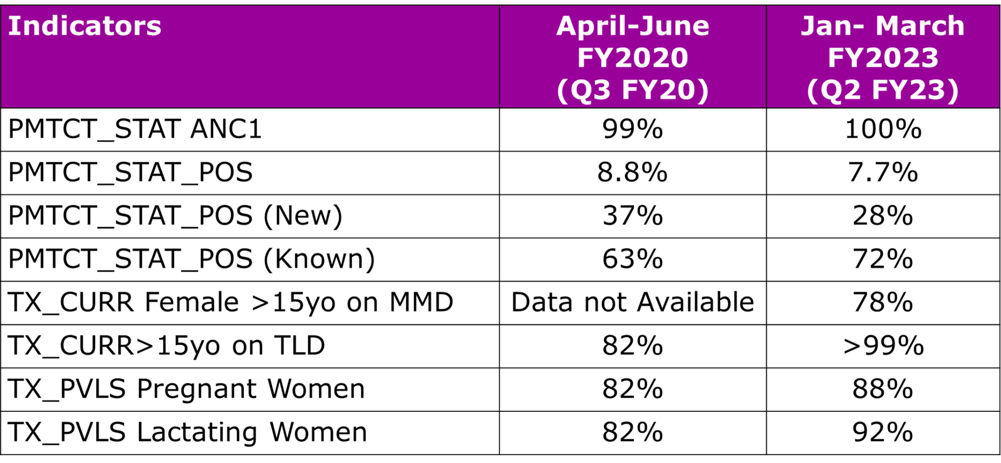
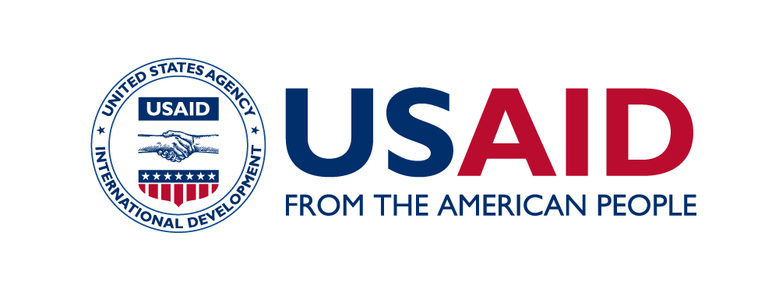
Successfully scaling community and facility interventions to support person-centered HIV services for pregnant and lactating women during the COVID-19 pandemic: Lessons learned from four provinces in Mozambique Argentina Wate¹, Rachel Golin², Ferreira Ferreira¹, Aleny Couto³, Námita Eliseu³, Kwalila Tibana³, Mércia Matsinhe¹, Sílvia Mikusova¹, Nidze Guiloviça¹ ¹United States Agency for International Development, Maputo, Mozambique; ² United States Agency for International Development, Office of HIV/AIDS, Washington, DC, USA; ³Government of Mozambique, Ministry of Health, Maputo, Mozambique
Background
Despite challenges, including COVID-19, Mozambique has advanced HIV services for pregnant and lactating women (PLW). USAID partners with the Government of Mozambique to achieve the UNAIDS 95-95-95 benchmarks among PLW living with HIV (PLWLHIV) and supports ~25% of PLWLHIV in Mozambique.
Lessons Learned
Programmatic data from 151 supported sites across the four provinces at the start of COVID-19 (April - June 2020 [quarter(Q)3 fiscal year (FY)20]) and after the initial COVID-19 peaks (last available reporting period: January - March 2023 [Q2 FY23]) was analyzed.
From Q3 FY20 to Q2 FY23, the HIV testing coverage among women attending the first antenatal consultation (ANC1) increased from 99% to 100%; the proportion of ANC1 clients living with HIV decreased from 8.8% (5,231/59,692) to 7.8% (5,079/65,299).
The proportion of newly diagnosed ANC1 clients decreased from 37% (1,952/5,231) to 28% (1,440/5,079), and conversely, the proportion of those with a known HIV+ status prior to ANC1 increased from 63% (3,279/5,231) to 72% (3,639/5,079).
In Q2 FY23, 78% of the general adult female HIV cohort received at least 3-months’ supply of ARVs (Q3 FY20 data unavailable) and >99% of dispensed adult HIV treatment regimens contained dolutegravir (from 82% at the start of Q3 FY20).
Viral load suppression improved among pregnant (82% to 88%) and lactating (82% to 92%) women.
Table 1. Comparison of PEPFAR Monitoring, Evaluation and Reporting Indicators* from Q3 FY20 to Q2 FY23
Description
USAID/Mozambique collaborated with the Ministry of Health and partners on the following COVID-19 program adaptations to improve HIV service delivery among PLW in Manica, Niassa, Sofala, and Tete provinces from April 2020 - March 2023:
Implemented the national Mentor Mothers (MM) strategy through 550 MM, including telephonic support to improve treatment continuity and viral load (VL) monitoring among PLWLHIV,
Appointed >100 MCH nurses to 97 high volume sites, and
Supported MCH staff to deliver HIV diagnostic, prevention, care and treatment, and psychosocial services for PLW (including viral load monitoring and multi-month dispensing of antiretroviral therapy and prophylaxis for opportunistic infections).
Conclusions/Next Steps
These data suggest that PLW-centered interventions support HIV diagnosis, optimized treatment, and VL suppression. Further analyses are needed to determine causal effects of interventions and scale best practices.
*PEPFAR’s Monitoring, Evaluation, and Reporting Indicator Reference Guides can be accessed here: https://help.datim.org/hc/en-us/articles/360000084446-MER-Indicator-Reference-Guides
Acknowledgements: The authors of this poster would like to thank and acknowledge program participants, health facility staff, community cadres,, civil society, and implementing partners for their partnership in the PMTCT program.
Disclaimer: This poster was made possible by the support of the American people through the U.S. States Department of State’s Bureau of Global Health and Security (GHSD) and the United States Agency for International Development (USAID) under the U.S. President's Emergency Plan for AIDS Relief (PEPFAR). The contents in this article are the sole responsibility of the authors, and do not necessarily reflect the views of GHSD, USAID, PEPFAR or the United States Government.

