Slide 1
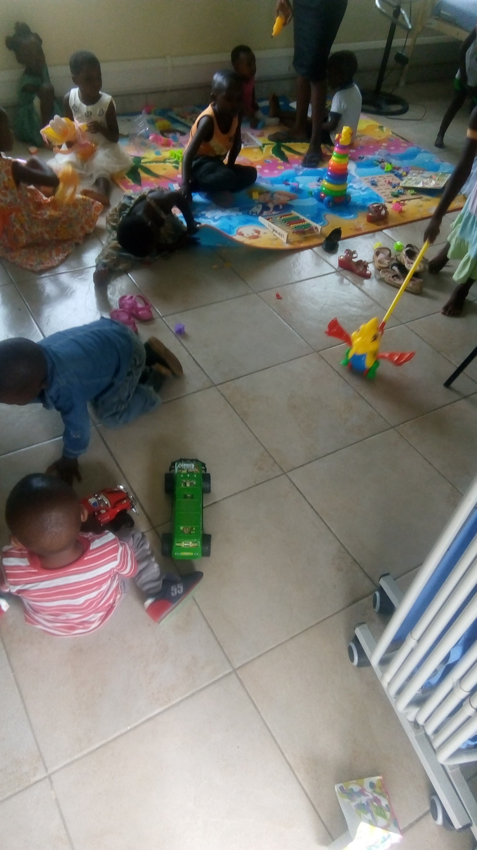
Enhancing viral load suppression in paediatric HIV through high viral load guardian sessions: lessons learnt from Lighthouse Trust Tisungane clinic in Zomba, Malawi Brown Gagamsataye¹, Gabriel Kamowatimwa¹, Clement Dziwe¹, Richard Mali¹, Thom Chaweza¹, Dr. Jacqueline Huwa¹, Christine Kiruthu-Kamamia^{1,2},Agness Thawani¹ ¹Lighthouse Trust, Lilongwe, Malawi, ²International Training and Education Center for Health, University of Washington, Seattle, WA, United States
Introduction
Children living with HIV have a higher risk of morbidity and mortality due to unsuppressed HIV viral load which increases risk of co-infections. The Malawi Population- based HIV Impact Assessment (MPHIA) 2021 reports a 42% low HIV viral load (VL) suppression rate among children compared to 98.0% in adults. In 2021, Lighthouse Trust rolled out the Pediatric differentiated service delivery (DSD) clinic for all children aged 0-5 years old, to improve VL suppression rate. The clinic introduced specialized sessions for guardians whose children had high VL (defined as> 1000 copies/ml). Monthly , all guardians whose children have high viral load have a group session with health providers. The guardian and the provider agree on the challenges identified and develop an action plan on how to solve the identified challenges.
Study Aim
The aim of the study was to evaluate the effect of high VL guardian sessions towards VL re-suppression among children aged 0-5 years enrolled in DSD care at Tisungane clinic in Zomba, Malawi.
Intervention
- The guardian session is a program within a DSD model “ART Kindergarten” for HIV positive children aged 0-5 years, aimed to support children with high viral load by providing a variety of quality HIV clinical services and psychosocial support in a baby friendly environment.
- Services offered include ART adherence counselling, disclosure, viral load monitoring, gender-based violence screening, Peer to peer mentorship and guardian orientation on monitoring clinic appointments.
- During the guardian session, a range of counselling methods are used to facilitate understanding of the relationship between HIV, viral load and CD4 count. –the counselling skills include; group counseling, individual counseling and peer to peer mentorship
Methods
We conducted a retrospective medical records review for children with high viral load aged 0-5years. Data was collected from electronic medical records, viral load sample log register and high viral load register. Data was collected on demographics, mental disorder, ART, viral load, disclosure and social support systems. The variables of interest were Viral load suppression rate at enrolment into the program and Viral load re-suppression rate after guardian session.
Results
Sixty-nine children (0-5 years) with mean age of 3years were enrolled in the pediatric DSD program from January 2021 to December 2022. At the enrolment into kindergarten clinic, baseline viral load was collected, and the results were; 31/69 (45%) children had suppressed VL (< 100 copies/ml), while 38/69 (55%) had a high Viral load ≥1000 copies/ml.
38 children with high viral load were put on monthly guardian sessions intervention. After the intervention, there was a statistically significant improvement in viral load suppression among the children. Following the intervention, the proportion of adolescents with re-suppressed viral load was 87% with 13% unsuppressed
Discussion
Our study demonstrated positive clinical and viral load re-suppression outcomes among children (aged 0-5 years), with 87% re-suppression rate. This brought overall suppression rate of 97% among the children in the kindergarten clinic. This is far much better in comparison with the Malawi Population- based HIV Impact Assessment (MPHIA) 2021 which reported a 42% viral suppression rate among these children aged 0-5 years.
These variations highlight the effectiveness of Lighthouse high viral load guardian session intervention on re-suppression viral load among children living with HIV. Our study contributes to the growing body of evidence supporting the importance of incorporating guardians into children's treatment and care to achieve at least 95% viral load suppression among children and adolescents.
Conclusion
Our study emphasizes the positive impact of high viral load guardian session on viral re-suppression outcomes for children with high viral load.
To enhance these outcomes, a range of counselling methods should be used to facilitate understanding of the relationship between HIV, viral load and CD4 count.
The counselling skills may include; group counseling, individual counseling and peer to peer mentorship

