Slide 1
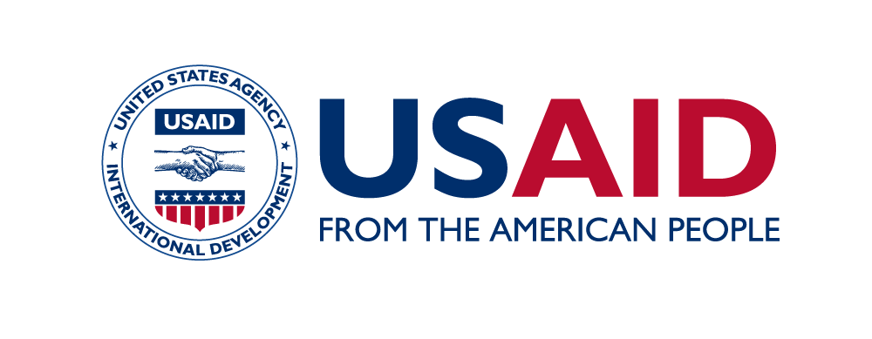
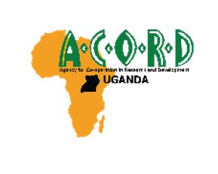
USAID’s Keeping Children Healthy and Safe Activity (KCHS) Abstract Presentation Catherine Kyokunzire (AVSI /KCHS), Denis Nuwagaba (TPO/KCHS), Magdalene Ndagire (AVSI/KCHS), Hussein Kato (TPO/KCHS)

Slide 2
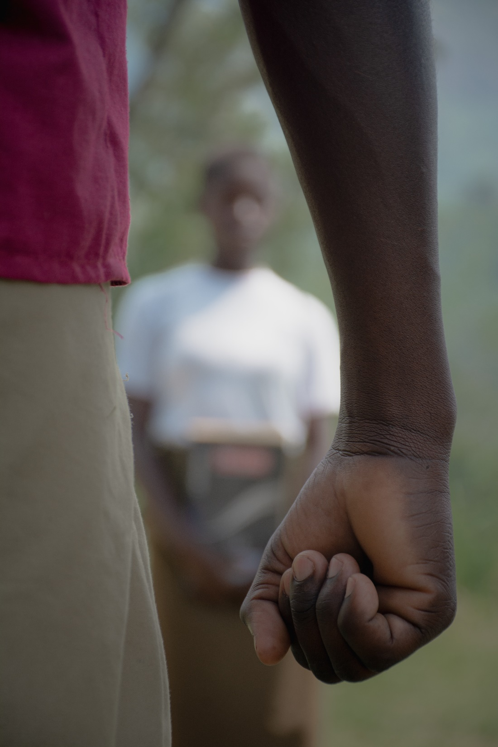
Strengthening prevention and response of violence against children to accelerated referral of children into HIV/AIDS Care: The Story of Working with District
Community-Based Services and Health Facilities

Slide 3
About KCHS Activity
USAID’s Keeping Children Healthy and Safe Activity (KCHS) is led by Transcultural Psychosocial Organisation [TPO] Uganda and implemented by AVSI Foundation in South Western Uganda

Slide 4
Project goal
To prevent new HIV infections and reduce vulnerability among orphans and vulnerable children (OVC) and adolescent girls and young women.

Slide 5
KCHS Approach
Strengthen and support the community based services department through identification, response and follow up of GBV and violence against children (VAC) cases.
Support to mentor and train the Community Development Officers, para social workers.
Functionality of child well-being committees at district and sub county level.
Popularization of reporting mechanisms.

Slide 6
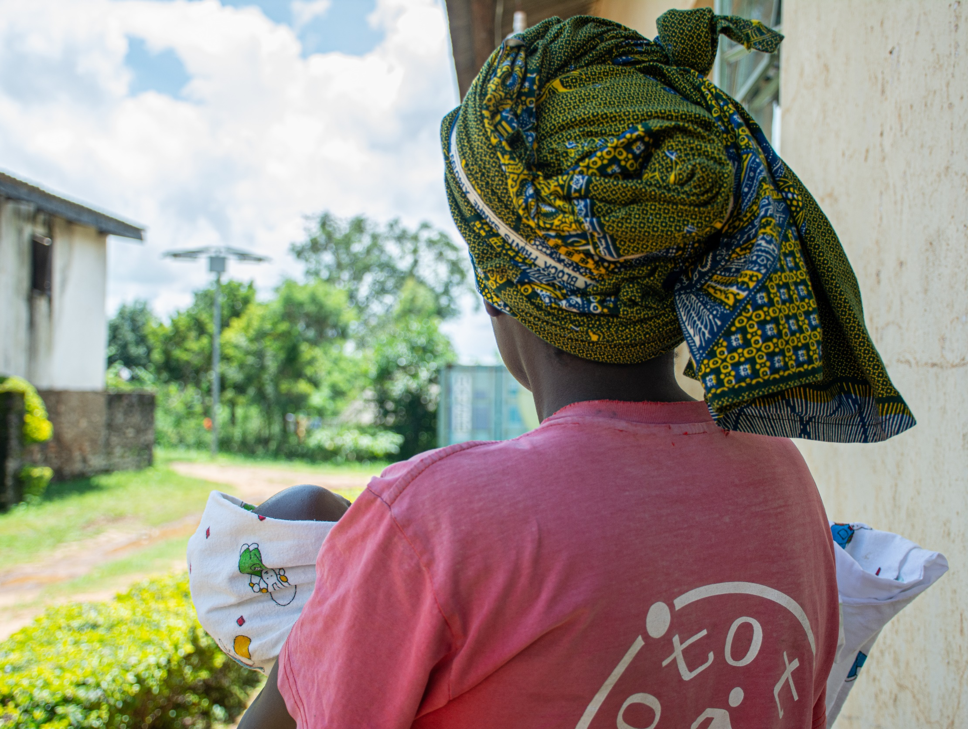
INSPIRE adopted strategies by KCHS
Parent and Care-giver support
Income and economic strengthening
Education and Life Skills training for youth

Slide 7
Violence and HIV – Uganda
Women (15-49 years of age) who had experienced intimate partner violence (physical and/or sexual and/or verbal) were 1.55 times more likely to subsequently acquire HIV than those who had never experienced such violence.
The study estimated that 22% of new HIV infections could be attributed to intimate partner violence.
Source: Kouyoumdjian FG, Calzavara LM, Bondy SJ, O’Campo P, Serwadda D, Nalugoda F. Intimate partner violence is associated with incident HIV infection in women in Uganda. AIDS. 2003;27:1331–8.
Notes:
Source: Kouyoumdjian FG, Calzavara LM, Bondy SJ, O’Campo P, Serwadda D, Nalugoda F. Intimate partner violence is associated with incident HIV infection in women in Uganda. AIDS. 2003;27:1331–8.

Slide 8
HIV statistics in Uganda
1.5 million - People living with HIV in Uganda (UNAIDS 2020).
53,000 - New HIV infections in Uganda (UNAIDS 2020).
65 percent - Children on ARV treatment (UNAIDS 2020).
7.9 percent - HIV prevalence - Kigezi region.

Slide 9
KCHS achievements
1250 children and 2112 adults living with HIV supported on KCHS program in Kigezi region.
4929 Orphans and Vulnerable Children supported.
210 referrals initiated and completed for various services.
500+ cases reported through various mechanisms

Slide 10
Conclusion
There is increased reporting of cases, referrals and linkages into HIV care due to the active role of child well-being committees and strengthened response of community-based services in Kigezi region.

Slide 11
Declaration of conflict of interest
No conflict of interest associated with this abstract

